Slide 1

COMPUTER NETWORKS
(BCSC 0008)
Copyright content, use only with the written permission of presenter mentioned
SWITCHING TECHNIQUES

Slide 2
Text and Reference Books
Text Books:
Fourouzan B. A. (2004), “Data Communication and Networking”, 4th Edition, McGraw-Hill.
References:
Kurose, J. F. and Ross K. W. (2005), “Computer Networking: A Top-Down Approach Featuring the Internet”, 3rd Edition, Addison-Wesley.
A. S. Tanenbaum (2006), “Computer Networks”, 2nd Edition, Prentice Hall India.

Slide 3
Previous discussed topics:
  OSI Model
  TCP/IP Model
  Addressing
  Data & Signals
  Transmission Media & Line Encoding
Now we will discuss:
  Concept of Switch
  Circuit, Packet and Message Switching Techniques

Slide 4
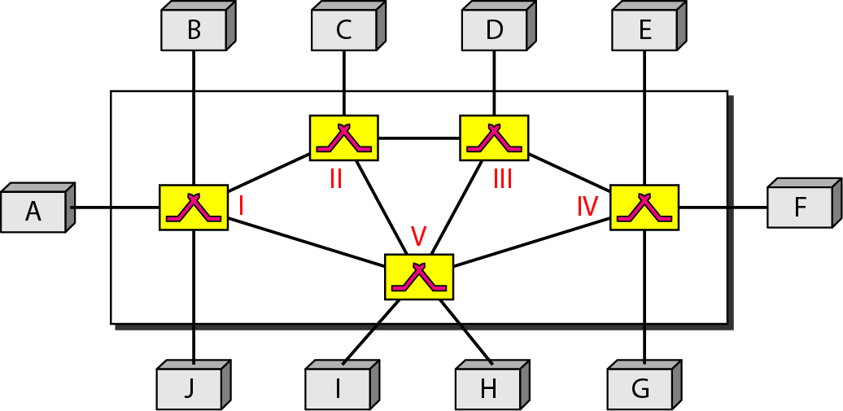
Switching Technique – Beyond Simple Topology
How 2 devices communicate when there are many devices?
One alternative is to establish Point to Point connection between each pair of devices using mesh topology (which is highly complex)
The other alternative is to use switching techniques leading to switched connection network.
Switched network

Slide 5
Switching Technique – Beyond Simple Topology
Important Points:
The end devices that wish to communicate are called stations.
The switching devices are called as nodes.
Some node connects to other nodes and other nodes are attached to stations.
Network topology is not regular.
There exist multiple paths between source to destination pair for better network reliability.
Switching nodes have no concerned with content of data and hence provides routing facility that will move data from node to node until they reach destination.

Slide 6
Switching Technique – Beyond Simple Topology
There are three typical switching techniques available for digital traffic.
  Circuit Switching (on physical layer)
  Message Switching (on network layer)
  Packet Switching
Message Switching is not in syllabus in midterm 2022

Slide 7
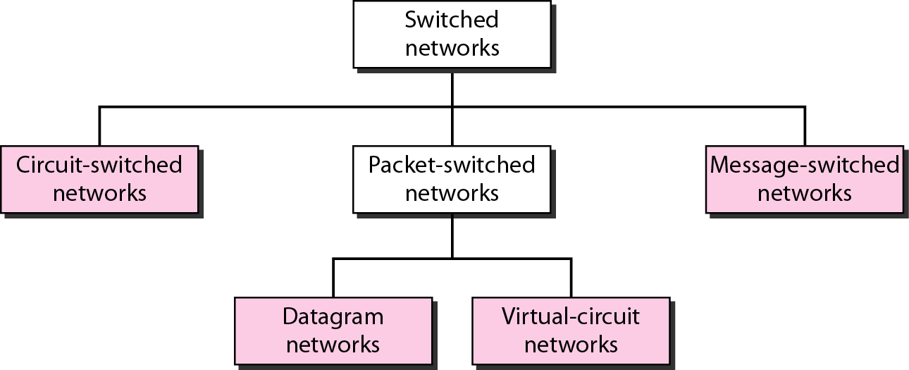
Taxonomy of switched networks

Slide 8
CIRCUIT-SWITCHED NETWORKS
A circuit-switched network consists of a set of switches connected by physical links. A connection between two stations is a dedicated path made of one or more links. However, each connection uses only one dedicated channel on each link. Each link is normally divided into n channels by using FDM or TDM.
Circuit switching was designed in 1878 in order to send telephone calls down a dedicated channel.
This channel remains open and in use throughout the whole call and cannot be used by any other data or phone calls.

Slide 9
Circuit Switching
Circuit switching is a technique that directly connects the sender and the receiver in an unbroken path.
Telephone switching equipment, for example, establishes a path that connects the caller's telephone to the receiver's telephone by making a physical connection.
With this type of switching technique, once a connection is established, a dedicated path exists between both ends until the connection is terminated.
Routing decisions must be made when the circuit is first established, but there are no decisions made after that time.

Slide 10
Circuit Switching
Circuit switching in a network operates almost the same way as the telephone system works.
A complete end-to-end path must exist before communication can take place.
The computer initiating the data transfer must ask for a connection to the destination.
Once the connection has been initiated and completed to the destination device, the destination device must acknowledge that it is ready and willing to carry on a transfer.

Slide 11
Circuit Switching
There are three phases in circuit switching:
  Establish ( Connection Establishment)
  Transfer (Data Transfer)
  Disconnect ( Connection Release or Tear Down)
  The message arrives in the same order that it was originally sent.
In modern circuit-switched networks, electronic signals pass through several switches before a connection is established.
During a call no other network traffic can use those switches.
The resources remain dedicated to the circuit during the entire data transfer and the entire message follows the same path.

Slide 12
Circuit Switching
Advantages:
The communication channel (once established) is dedicated.
Disadvantages:
Possible long wait to establish a connection, (10 seconds, more on long- distance or international calls.) during which no data can be transmitted.
More expensive than any other switching techniques, because a dedicated path is required for each connection.
Inefficient use of the communication channel, because the channel is not used when the connected systems are not using it.

Slide 13

Note
In circuit switching, the resources need to be reserved during the setup phase; the resources remain dedicated for the entire duration of data transfer until the teardown phase.
A circuit-switched network is made of a set of switches connected by physical links, in which each link is divided into n channels.
Switching at the physical layer in the traditional telephone network uses the circuit-switching approach.

Slide 14
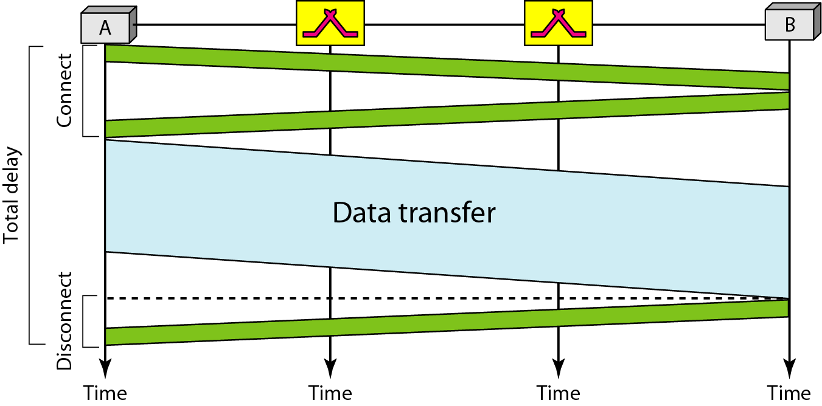
Delay in a circuit-switched network
Total Delay in a circuit-switched network will be delay for setup and tear down +
Propagation delay + Transmission delay i.e.
Total Delay= Propagation time + Transmission time + Setup + Tear down

Slide 15
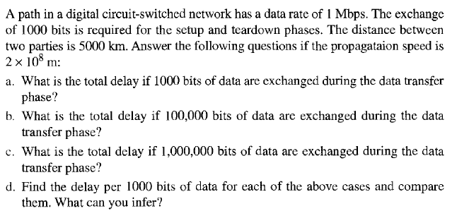
Circuit switching-Question

Slide 16
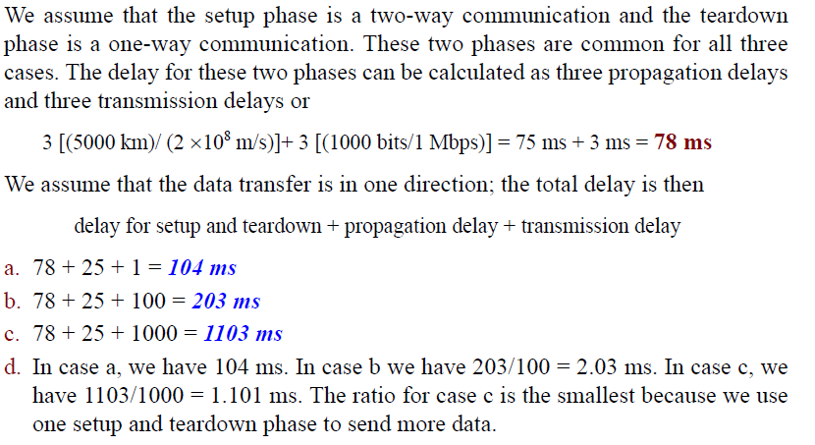
Circuit switching-Question Solution

Slide 17
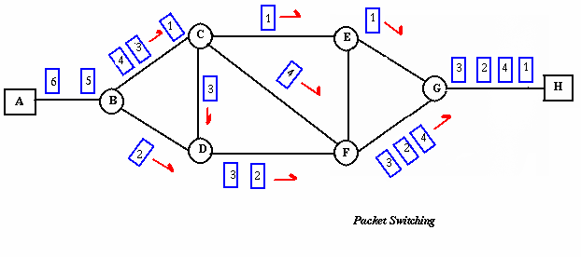
Packet Switching
In packet-based networks, the message gets broken into small data packets. These packets are sent out from the computer and they travel around the network seeking out the most efficient route to reach to destination. This does not necessarily mean that they seek out the shortest route. Each packet may go a different route from the others.
There are two methods of packet switching: Datagram and virtual circuit packet switching

Slide 18
Packet Switching
In both packet switching methods, a message is broken into small parts, called packets.
Each packet is tagged with appropriate source and destination addresses.
Since packets have a strictly defined maximum length, they can be stored in main memory instead of disk, therefore access delay and cost are minimized.
Also the transmission speeds, between nodes, are optimized.
With current technology, packets are generally accepted onto the network on a first-come, first-served basis. If the network becomes overloaded, packets are delayed or discarded (``dropped'').

Slide 19
DTAGRAM NETWORKS
An Approach of Packet Switching
In data communications, we need to send messages from one end system to another. If the message is going to pass through a packet-switched network, it needs to be divided into packets of fixed or variable size. The size of the packet is determined by the network and the governing protocol.

Slide 20
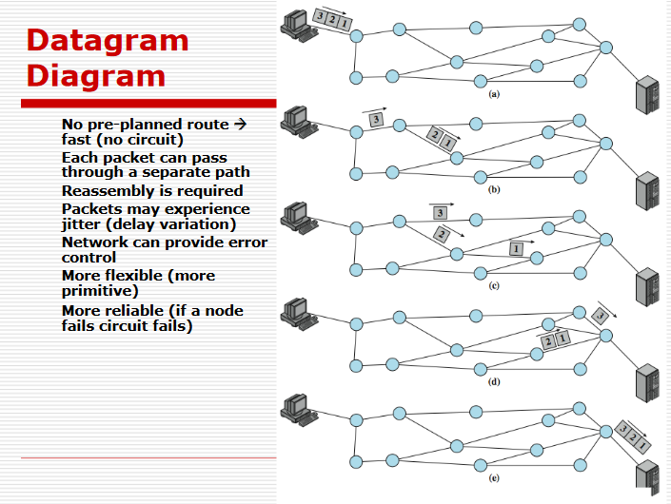
Packet Switching Datagram Approach –Connectionless

Slide 21
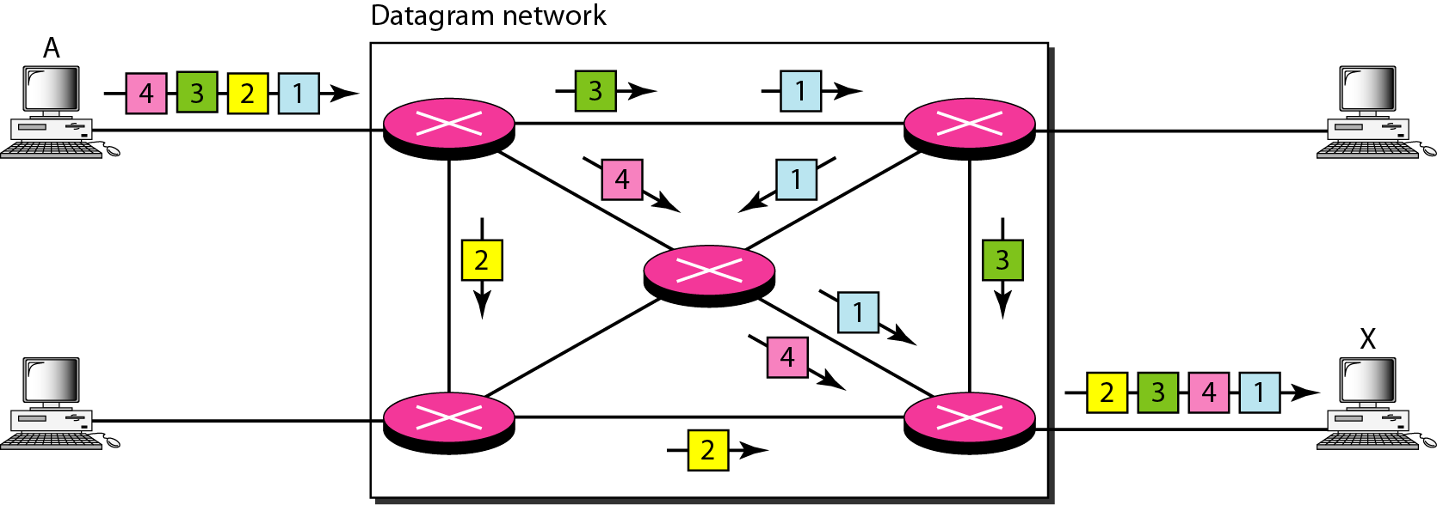
A datagram network with four switches (routers)

Slide 22
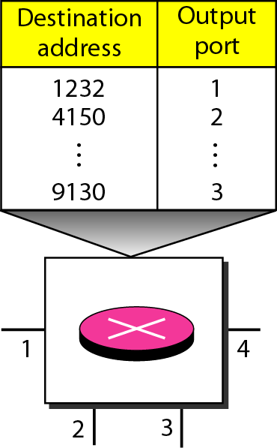
Routing table in a datagram network

Slide 23
Note
In a Datagram packet-switched network, there is no resource reservation; resources are allocated on demand.
A switch in a datagram network uses a routing table that is based on the destination address.
The destination address in the header of a packet in a datagram network remains the same during the entire journey of the packet.
Switching in the Internet is done by using the datagram approach to packet switching at the network layer.

Slide 24
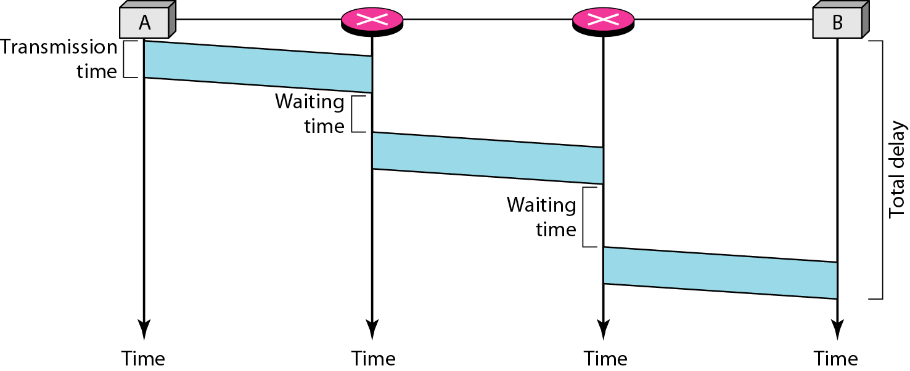
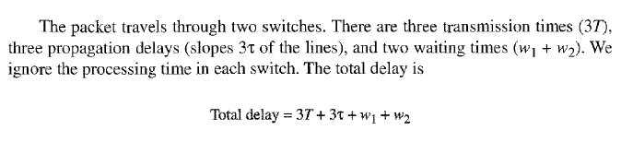
Delay in a datagram network

Slide 25
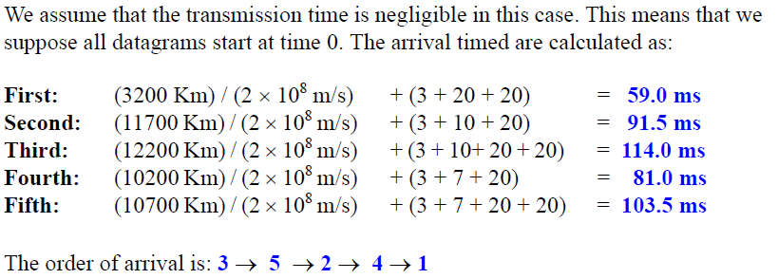
Five equal-size datagram belonging to the same message leave for the destination one after another. However, they travel through different paths as shown in Table
Datagram Path Length Visited Switches
1 3200Km 1,3,5
2 11,700 Km 1,2,5
3 12,200 Km 1,2,3,5
4 10,200 Km 1,4,5
5 10,700 Km 1,4,3,5
We assume that the delay for each switch (including waiting and processing) is 3,10, 20, 7, and 20 ms respectively. Assuming that the propagation speed is 2 x 10⁸ m,
find the order the datagram arrive at the destination and the delay for each. Ignore any other delays in transmission.
Datagram switching-Question Solution

Slide 26
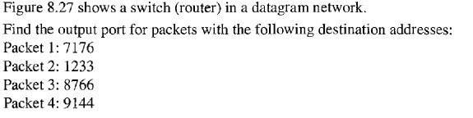
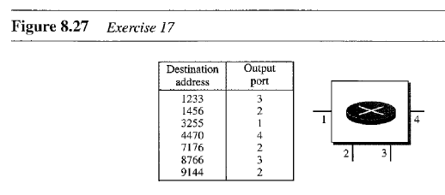
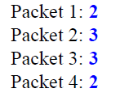
Datagram switching-Question Solution

Slide 27
VIRTUAL CIRCUIT-SWITCHED NETWORKS
An Approach of Packet Switching
A virtual-circuit network is a cross between a circuit-switched network and a datagram network. It has some characteristics of both.
Virtual-Circuit network offer guarantees that :
  the packets sent arrive in the order sent
  with no duplicates or omissions
  with no errors (with high probability)
regardless of how they are implemented internally.

Slide 28
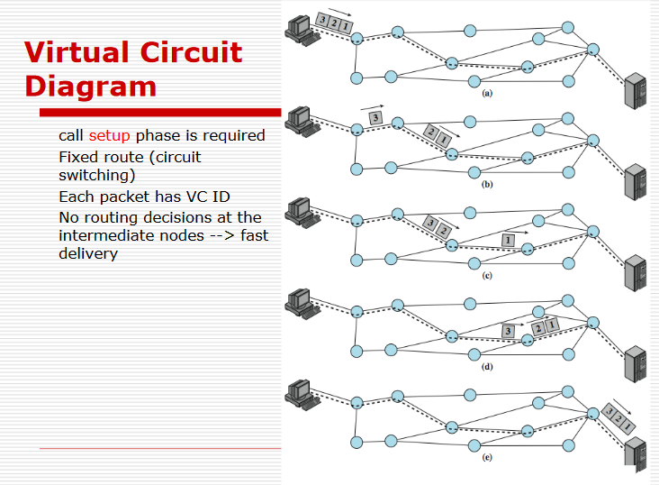
Packet Switching Virtual Circuit Approach
Connection Oriented

Slide 29
Packet Switching Virtual Circuit Approach
Connection Oriented
A virtual-circuit network is a cross between a circuit-switched network and a datagram network. It has some characteristics of both.
As in a circuit-switched network, there are setup and teardown phases in addition to the data transfer phase.
Resources can be allocated during the setup phase, as in a circuit-switched network, or on demand, as in a datagram network.
As in a datagram network, data are packetized and each packet carries an address in the header. However, the address in the header has local jurisdiction (it defines what should be the next switch and the channel on which the packet is being carried), not end-to-end jurisdiction.

Slide 30
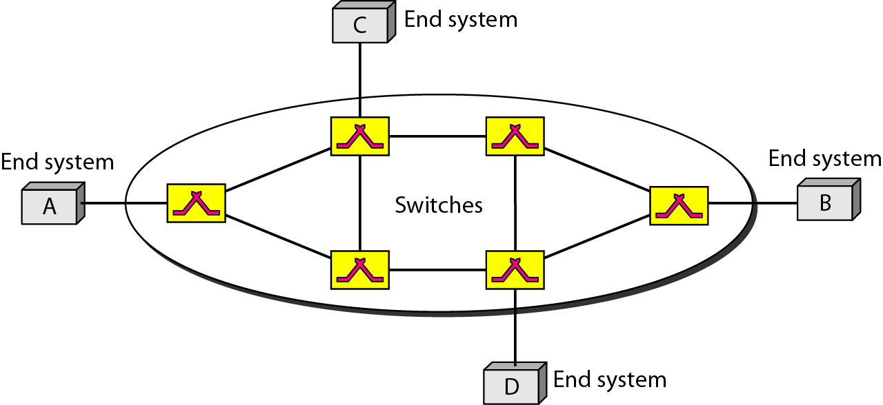
Packet Switching Virtual Circuit Approach
Connection Oriented
As in a circuit-switched network, all packets follow the same path established during the connection.
A virtual-circuit network is normally implemented in the data link layer, while a circuit-switched network is implemented in the physical layer and a datagram network in the network layer. But this may change in the future.
Virtual-circuit network

Slide 31
Packet Switching Virtual Circuit Approach
How it is implemented ?
Addressing: In a virtual-circuit network, two types of addressing are involved: global and local (virtual-circuit identifier).
Global Addressing: A source or a destination IP address is considered to be global address.
Virtual-Circuit Identifier: The identifier that is actually used for data transfer is called the virtual-circuit identifier (VCI). A VCI, unlike a global address, is a small number that has only switch scope. It is used by a frame between two switches. When a frame arrives at a switch, it has a VCI; when it leaves, it has a different VCI.

Slide 32
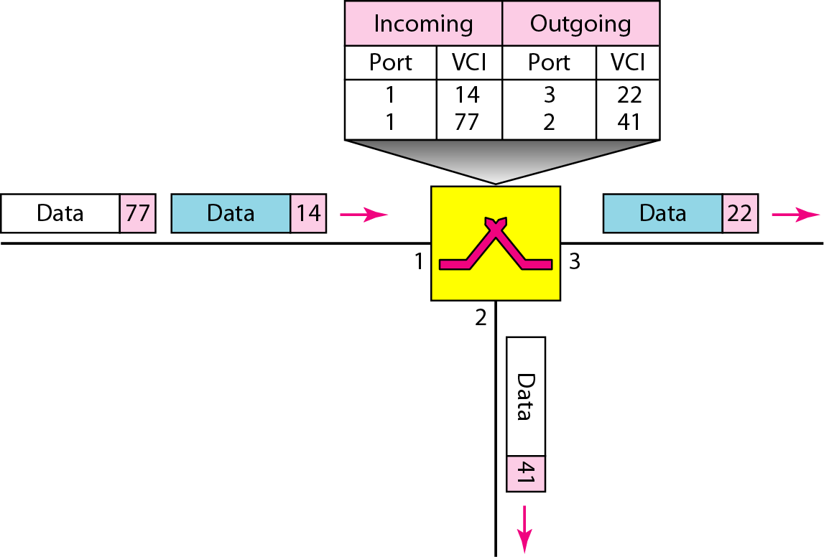
Switch and tables in a virtual-circuit network

Slide 33
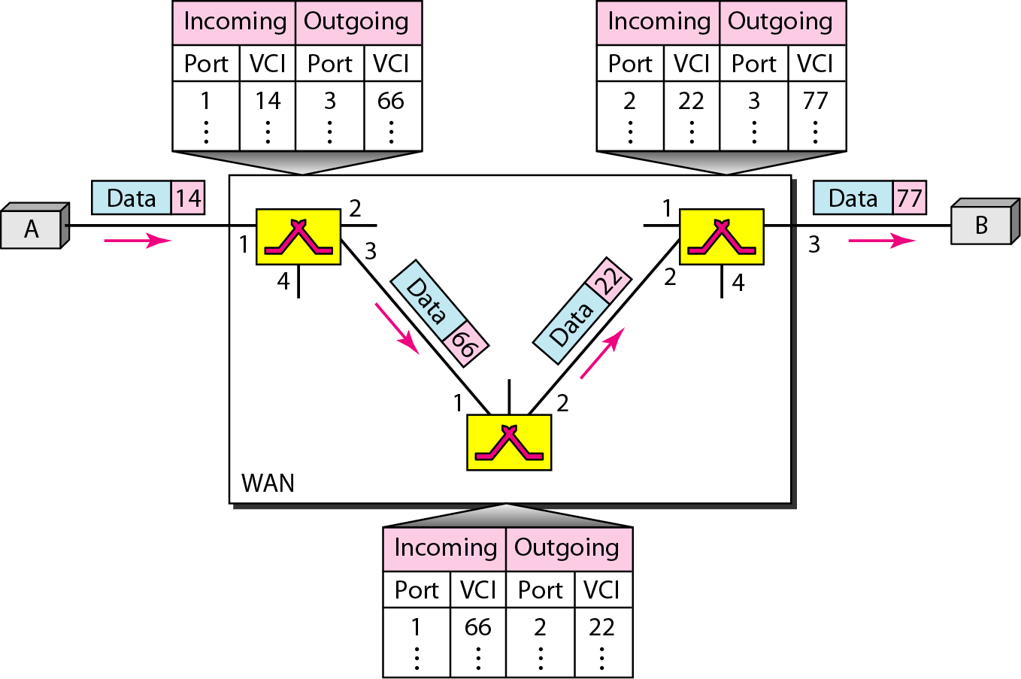
Source-to-destination data transfer in a virtual-circuit network
The following figure shows a frame arriving at port 1 with a VCI of 14. When the frame arrives, the switch looks in its table to find port 1 and a VCI of 14. When it is found, the switch knows to change the VCI to 66 and send out the frame from port 3.

Slide 34
Packet Switching Virtual Circuit Approach
How Virtual Circuit is Established ?
Three Phases:
As in a circuit-switched network, a source and destination need to go through three phases in a virtual-circuit network: setup, data transfer, and teardown.
Setup phase, the source and destination use their global addresses to help switches make table entries for the connection.
In the teardown phase, the source and destination inform the switches to delete the corresponding entry.
Data transfer occurs between these two phases.

Slide 35
Packet Switching Virtual Circuit Approach
How Virtual Circuit is Established ?
Setup Phase:
In the setup phase, a switch creates an entry for a virtual circuit. For example, suppose source A needs to create a virtual circuit to B. Two steps are required: the setup request and the acknowledgment.
Setup Request: A setup request frame is sent from the source to the destination.
Acknowledgment: A special frame, called the acknowledgment frame, completes the entries in the switching tables.

Slide 36
Packet Switching Virtual Circuit Approach
How Virtual Circuit is Established ?
Consider the example diagram of slide 33
Source A sends a setup frame to switch 1.
Switch 1 receives the setup request frame. It knows that a frame going from A to B goes out through port 3. The switch, in the setup phase, acts as a packet switch and it has a routing table which is different from the switching table. For the moment, assume that it knows the output port. The switch creates an entry in its table for this virtual circuit, but it is only able to fill three of the four columns. The switch assigns the incoming port (1) and chooses an available incoming VCI (14) and the outgoing port (3). It does not yet know the outgoing VCI, which will be found during the acknowledgment step. The switch then forwards the frame through port 3 to switch 2.

Slide 37
Packet Switching Virtual Circuit Approach
How Virtual Circuit is Established ?
Consider the example diagram of slide 33
Switch 2 receives the setup request frame. The same events happen here as at switch 1 and three columns of the table are completed: in this case, incoming port (l), incoming VCI (66), and outgoing port (2).
Switch 3 receives the setup request frame. Again, three columns are completed: incoming port (2), incoming VCI (22), and outgoing port (3).
Destination B receives the setup frame, and if it is ready to receive frames from A, it assigns a VCI to the incoming frames that come from A, in this case 77. This VCI lets the destination know that the frames come from A, and no other sources.
See the example diagram in next slide for setup phase

Slide 38
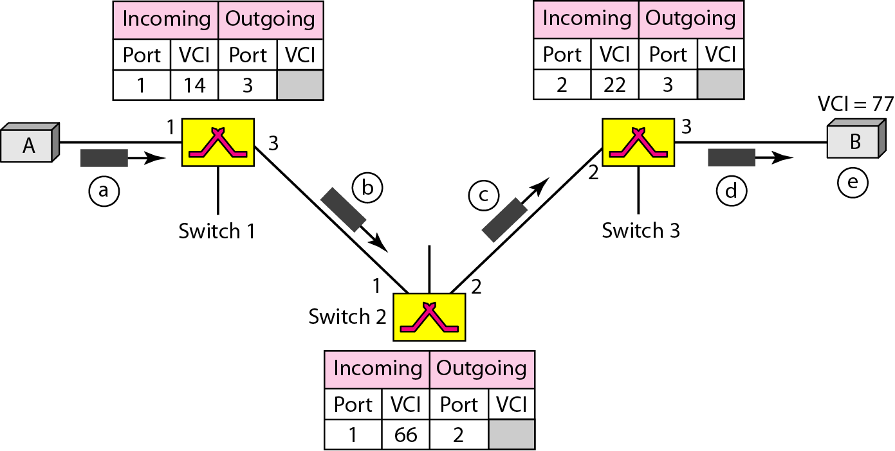
Setup request in a virtual-circuit network

Slide 39
Packet Switching Virtual Circuit Approach
How Virtual Circuit is Established ?
Consider the example diagram of slide 38
The destination sends an acknowledgment to switch 3. The acknowledgment carries the global source and destination addresses so the switch knows which entry in the table is to be completed. The frame also carries VCI 77, chosen by the destination as the incoming VCI for frames from A. Switch 3 uses this VCI to complete the outgoing VCI column for this entry. Note that 77 is the incoming VCI for destination B, but the outgoing VCI for switch
Switch 3 sends an acknowledgment to switch 2 that contains its incoming VCI in the table, chosen in the previous step. Switch 2 uses this as the outgoing VCI in the table.

Slide 40
Packet Switching Virtual Circuit Approach
How Virtual Circuit is Established ?
Consider the example diagram of slide 38
Switch 2 sends an acknowledgment to switch 1 that contains its incoming VCI in the table, chosen in the previous step. Switch 1 uses this as the outgoing VCI in the table.
Finally switch 1 sends an acknowledgment to source A that contains its incoming VCI in the table, chosen in the previous step.
The source uses this as the outgoing VCI for the data frames to be sent to destination B.
See the example diagram in next slide for setup-
acknowledgment phase

Slide 41
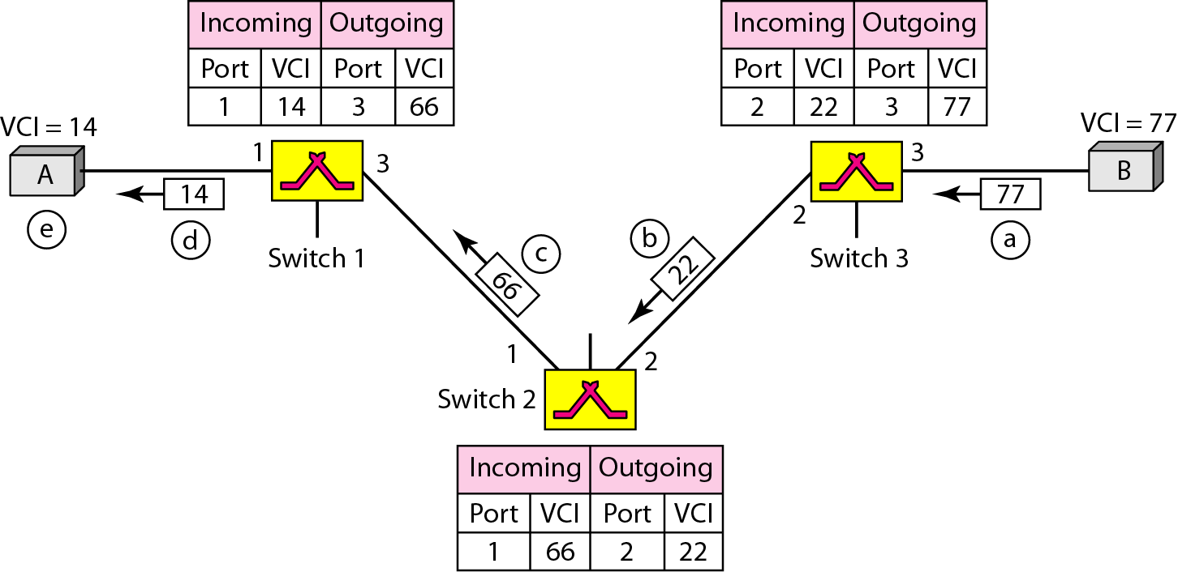
Setup acknowledgment in a virtual-circuit network

Slide 42
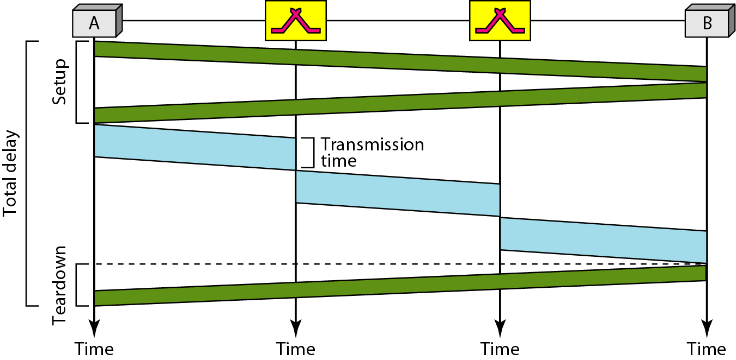

Delay in a virtual-circuit network

Slide 43
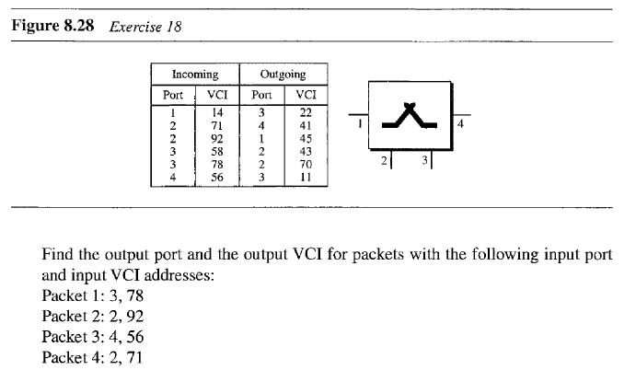
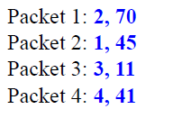
Virtual Circuit switching-Question Solution

Slide 44
Advantages of packet switching
Packet switching is cost effective, because switching devices do not need massive amount of secondary storage.
Packet switching offers improved delay characteristics, because there are no long messages in the queue (maximum packet size is fixed).
Packet can be rerouted if there is any problem, such as, busy or disabled links.
The advantage of packet switching is that many network users can share the same channel at the same time. Packet switching can maximize link efficiency by making optimal use of link bandwidth.

Slide 45
Disadvantages of packet switching
  Protocols for packet switching are typically more complex.
  It can add some initial costs in implementation.
  If packet is lost, sender needs to retransmit the data.
  Another disadvantage is that packet-switched systems still can’t deliver the same quality as dedicated circuits in applications requiring very little delay - like voice conversations or moving images.

Slide 46
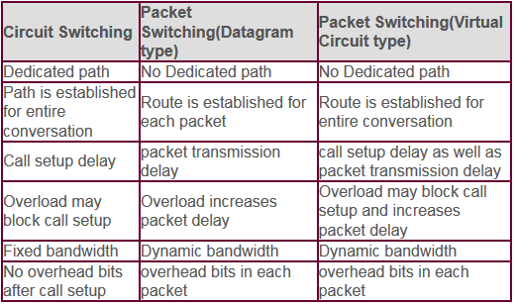
Comparative Analysis
Circuit, Datagram & Virtual Circuit Switching

Slide 47
It is not in our syllabus now 2022
Message Switching
With message switching there is no need to establish a dedicated path between two stations.
When a station sends a message, the destination address is appended to the message.
The message is then transmitted through the network, in its entirety, from node to node.
Each node receives the entire message, stores it in its entirety on disk, and then transmits the message to the next node.
This type of network is called a store-and-forward network.
A message-switching node is typically a general-purpose computer. The device needs sufficient secondary-storage capacity to store the incoming messages, which could be long. A time delay is introduced using this type of scheme due to store- and-forward time, plus the time required to find the next node in the transmission path.

Slide 48
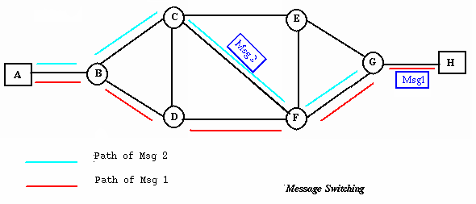
Message Switching

Slide 49
SWITCH
Structure of a Switch
We use switches in circuit-switched and packet-switched networks.
A switch is a device in a computer network that connects other devices together. Multiple data cables are plugged into a switch to enable communication between different networked devices.
A switch is a device that is used at the Access or OSI Layer 2; a switch can be used to connect multiple hosts (PCs) to the network. Unlike a hub, a switch forwards a message to a specific host.

Slide 50
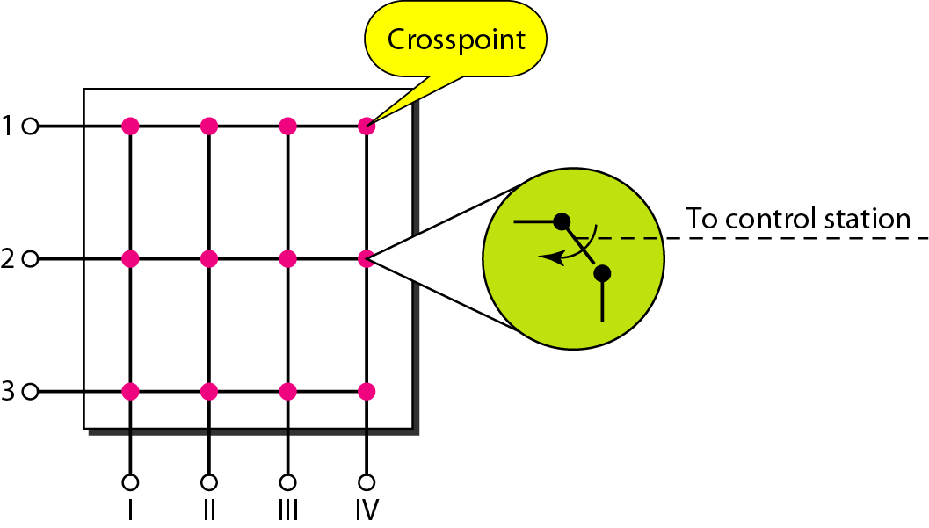
Crossbar switch with three inputs and four outputs

Slide 51
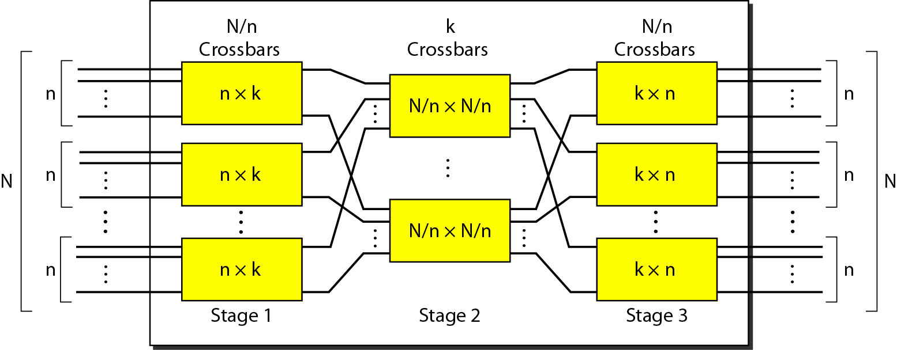
Multistage switch

Slide 52
Note
In a three-stage switch, the total number of cross points is 2kN + k(N/n)² which is much smaller than the number of cross points in a single-stage switch (N²).

Slide 53
Example
Design a three-stage, 200 × 200 switch (N = 200) with
k = 4 and n = 20.
Solution
In the first stage we have N/n or 10 crossbars, each of size 20 × 4. In the second stage, we have 4 crossbars, each of size 10 × 10. In the third stage, we have 10 crossbars, each of size 4 × 20. The total number of cross points is 2kN + k(N/n)², or 2000 cross points. This is 5 percent of the number of cross points in a single-stage switch (200 × 200 = 40,000).

